Slide 1
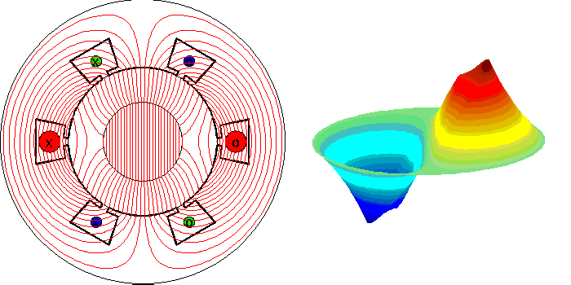
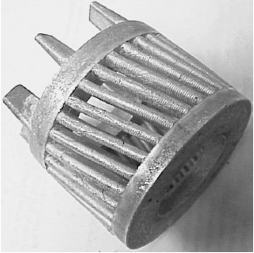
Induction Machines
STEADY STATE MODELING

Slide 2
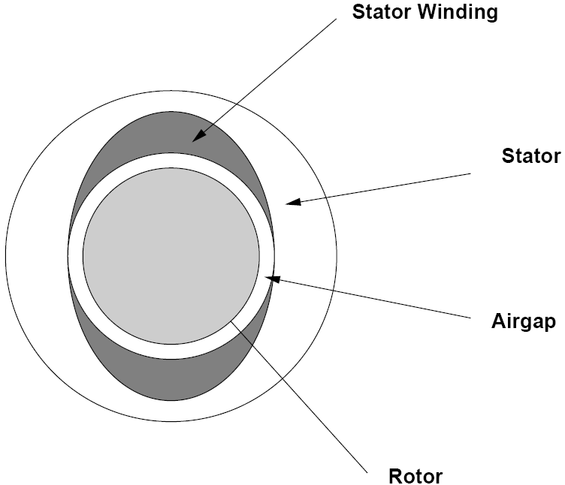

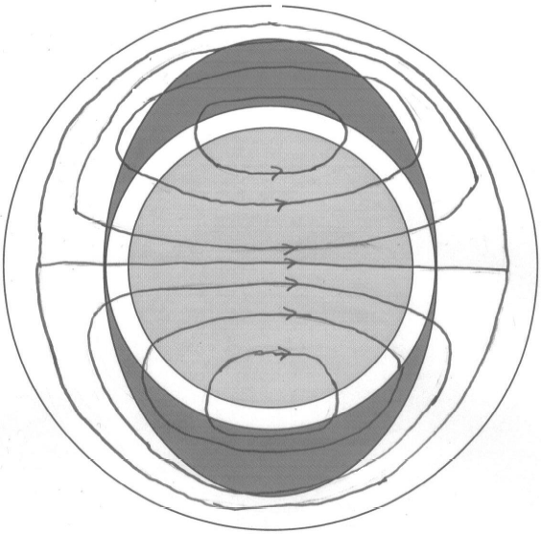
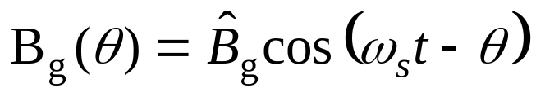
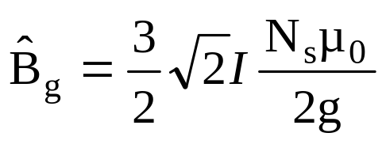
AC Machinery Fundamentals
Rotating flux
Sinusoidal winding on the stator
We have already shown that the flux density of a three phase winding carrying three phase currents will be:

Slide 3
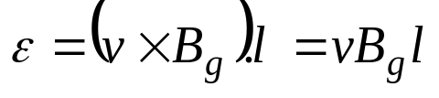
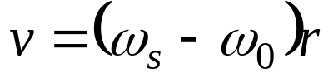
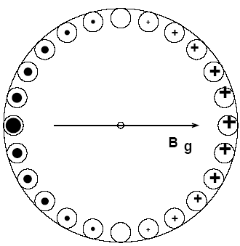
Induction Machines
OPERATION NEAR SYNCHRONOUS SPEED
Induced voltage in the bars :
v is the relative velocity of the rotor with respect to the field:
ω_{s} and ω_{o} are the mechanical synchronous speed and rotor speed
The bars are short circuited, currents will flow in them. These currents are out of phase in different bars, just like the induced voltages.

Slide 4
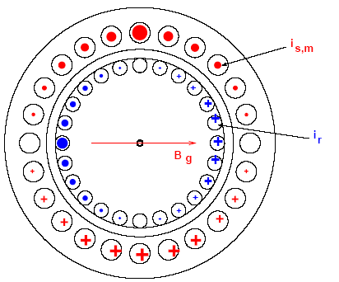
Induction Machines
OPERATION NEAR SYNCHRONOUS SPEED
The voltages induced in the rotor bars are of slip frequency,
f_{r}= (ω_{s}-ω₀)/2π. At rotor speeds near synchronous, this frequency, f_{r} is quite small. The rotor bars in a squirrel cage machine possess resistance and leakage inductance, but at very low frequencies, i.e near synchronous speed, we can neglect this inductance. The rotor currents therefore are limited near synchronous speed by the rotor resistance only.

Slide 5
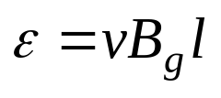
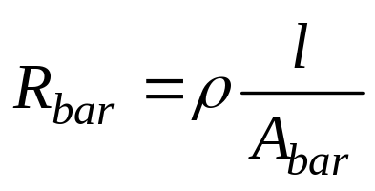
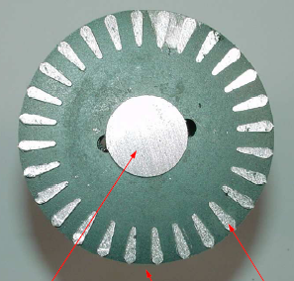
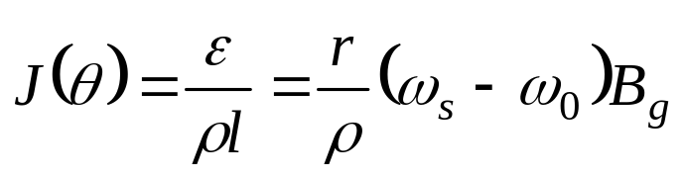
Induction Machines
OPERATION NEAR SYNCHRONOUS SPEED
Induced voltage in the bars :
The rotor resistance of each bar
The current density J (θ) will be:
Note: ω_{s} is the mechanical synchronous speed and ω_{o} is the mechanical speed of the rotor.

Slide 6
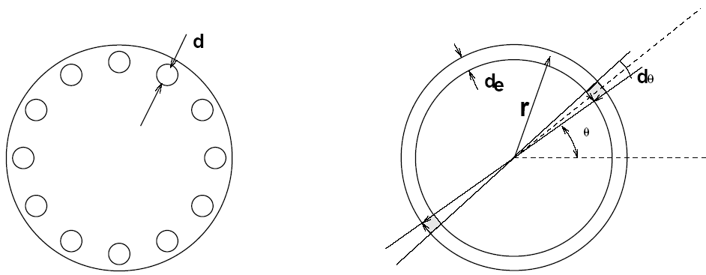
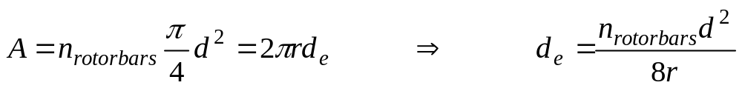
Induction Machines
OPERATION NEAR SYNCHRONOUS SPEED
We can replace the bars with a conductive cylinder with a thickness of d_{e}. Let A be the cross section of all the bar.

Slide 7
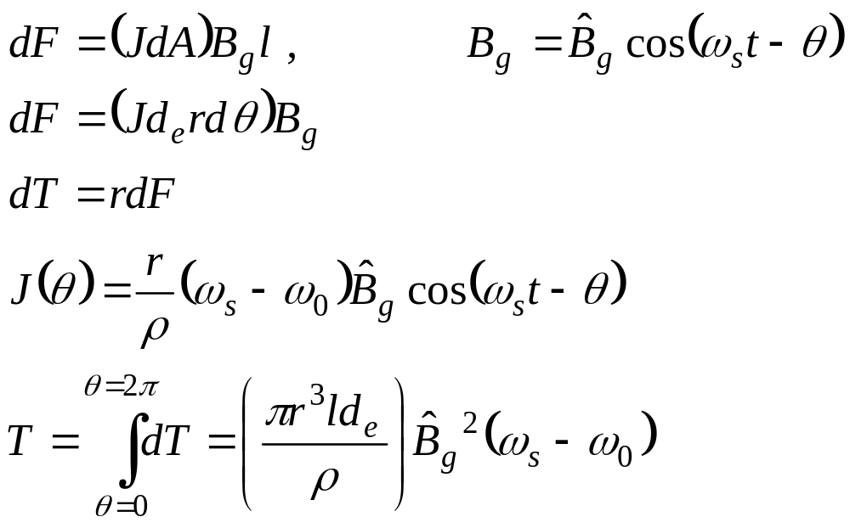
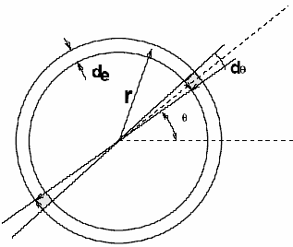
Induction Machines
Torque Development
For a small angle dθ at an angle θ, we calculate the contribution to the total force and torque:
Note that the current distribution in bars also rotates in synchronous speed regardless of rotor rotational speed.

Slide 8
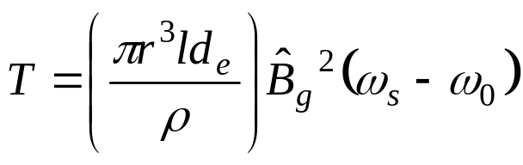
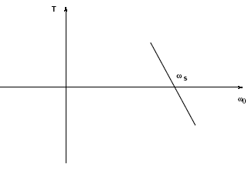
Induction Machines
Torque Development
The torque is proportional to the frequency of the rotor currents ω_{s}-ω₀, and the square of the flux density. This is so, since the torque comes from the interaction of the flux density B_{g} and the rotor currents. But the rotor currents are induced due to the flux B_{g} and the relative speed ω_{s}-ω₀.

Slide 9
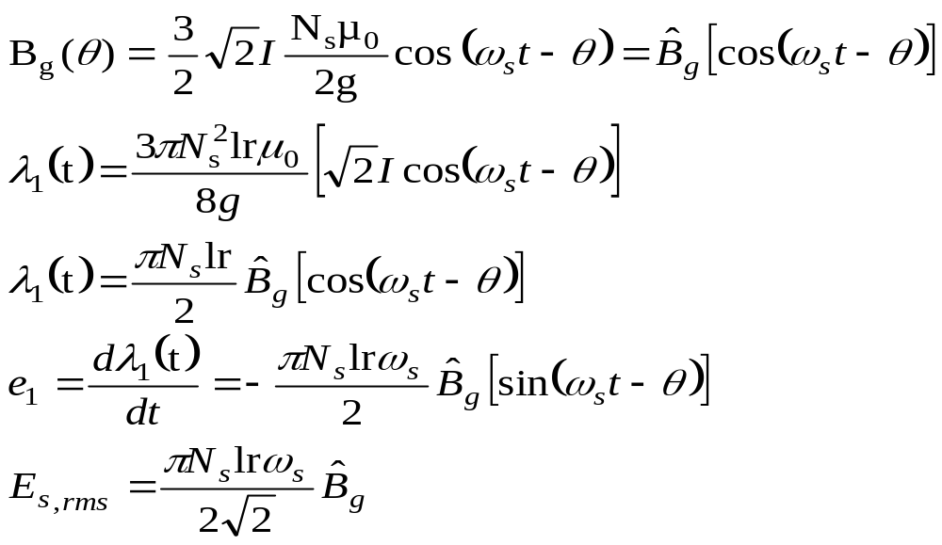
Induction Machines
Torque Development
Flux density in the air gap is not an easy quantity to work with, so we can use the relationship between flux density and stator voltage. Remember that for a three phase winding we have:

Slide 10
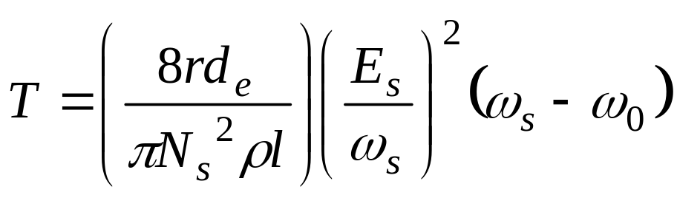
Induction Machines
Torque Development
Replacing Flux density in the air gap by the rms value of the induced voltage in each winding gives:

Slide 11
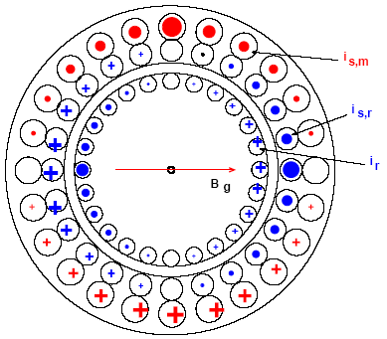
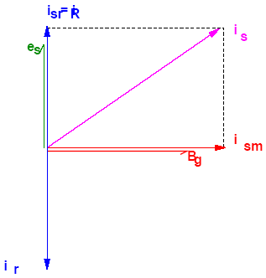
Induction Machines
Equivalent Circuit
Applying a three-phase voltage e_{s} to the stator windings, means that an air-gap flux B_{g}, which is 90º lagging shall exist. Because of the magnetizing inductance a current i_{s} will flow in the stator windings in phase to the flux vector.

Slide 12
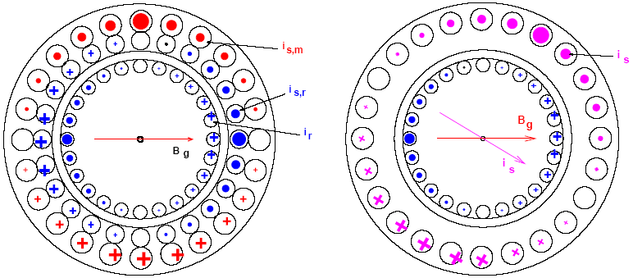
Induction Machines
Equivalent Circuit
The rotor current, i_{r} produces additional air-gap flux, which is 90º out of phase of the magnetizing flux. But the stator voltage, e_{s}, is applied externally and it is proportional to and 90º out of phase of
the air gap flux. Additional currents, i_{sr} will flow in the stator windings in order to cancel the flux due to the rotor currents.

Slide 13
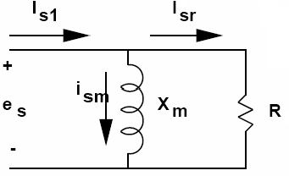
Induction Machines
Equivalent Circuit
In other word if it would supposed to have the air-gap flux density B_{g} , an additional current component in stator shall exist.
We can split the stator current of one phase, i_{s1}, into two components: One in phase with the voltage, i_{sr1} and one 90º behind it, i_{sm1}. The first reflects the rotor current, while the second depends on the voltage and frequency. In an equivalent circuit, this means that i_{sr1} will flow through a resistor, and i_{sm1} will flow through an inductor.

Slide 14
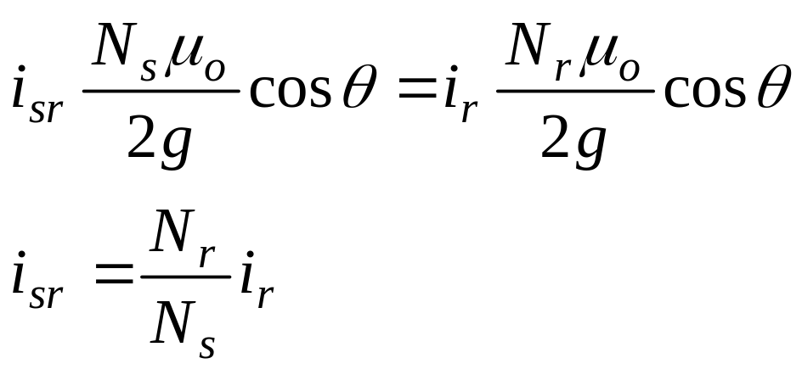
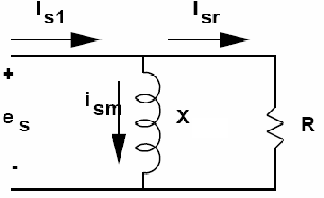
Induction Machines
Equivalent Circuit
According to Lenz law the rotor field is compensated by the field produced by i_{sr} in the stator winding. If the two windings are assumed to be sinusoidally distributed then:

Slide 15
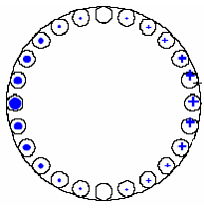
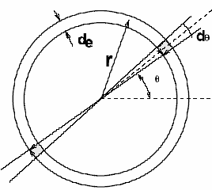
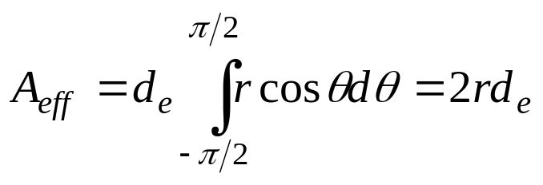
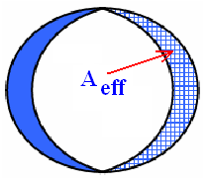
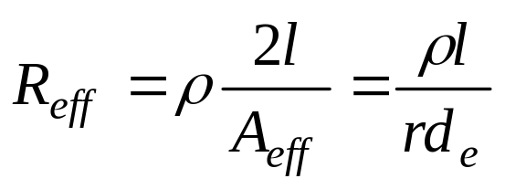
Induction Machines
Equivalent Circuit
The current in the rotor conducting sheet has a sinusoidal distribution of current density. It can be considered as a uniform current distribution in a conducting sheet with a sinusoidal distributed thickness. The effective cross section area of the rotor conducting sheet is:
So the effective resistance of this rotor single loop winding is:

Slide 16
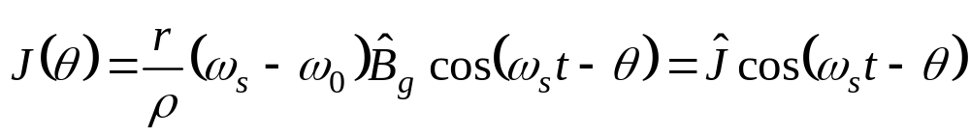
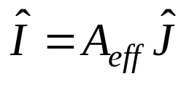
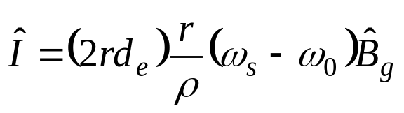
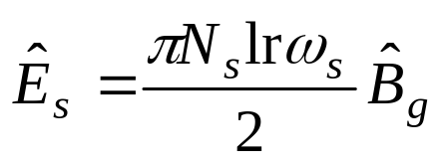
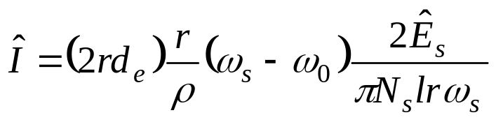
Induction Machines
Equivalent Circuit
Recall the current density and calculate the current:
We can write this in terms of the induced voltage

Slide 17
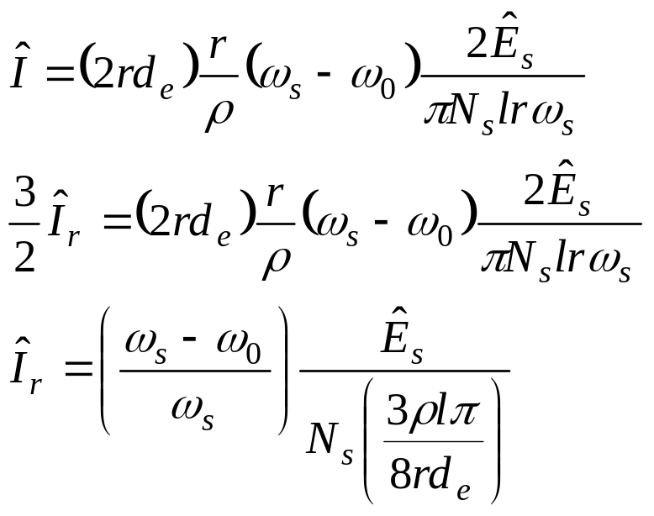
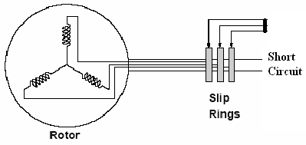
Induction Machines
Equivalent Circuit
We could assume that the rotating field of rotor arises from a three phase winging. In a wound rotor it actually is. Recall that the per-phase current in this case is 2/3 times the equivalent winding current. I^_{r} denotes the peak per-phase rotor current.

Slide 18
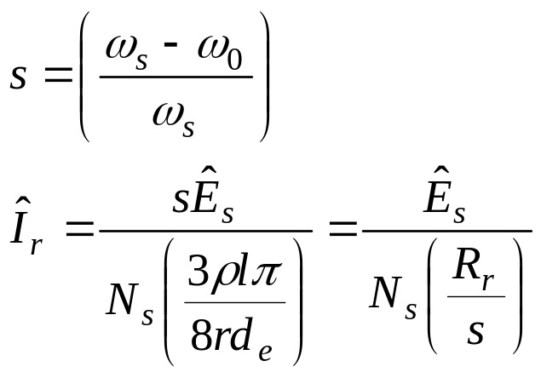
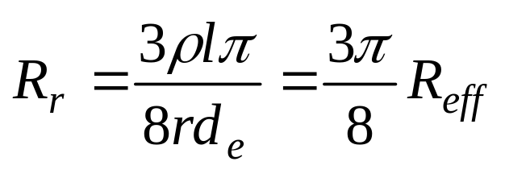
Induction Machines
Equivalent Circuit
In terms of slip (s):
Where:

Slide 19
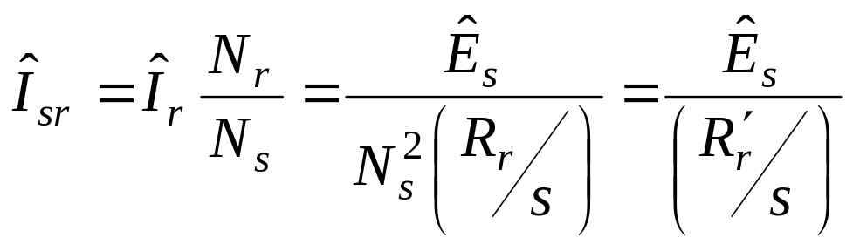
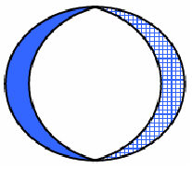
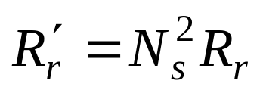
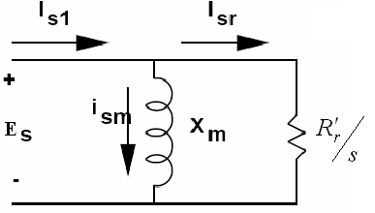
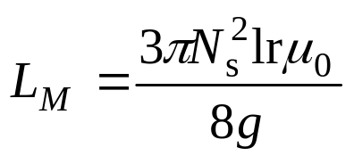
Induction Machines
Equivalent Circuit
The rotor conducting sheet is a single turn winding; Nr=1, so:
Hence the per-phase equivalent circuit of induction machine comes out. We have already found the per phase magnetizing inductance:

